Slide 1





Facial Expression Recognition System
This project report details the development of a Facial Impression Recognition System, an AI-driven application designed to detect and classify human facial expressions using Python, OpenCV, and deep learning. The system leverages the power of deep neural networks (DNNs) to accurately identify emotions such as happiness, sadness, anger, surprise, fear, and neutrality from facial images or video streams.
Ayesha Asghar
Muhammad Ali
26-08-2024

Slide 2


Introduction
Facial expressions are a fundamental aspect of human communication, conveying emotions and intentions often without the need for words. Recognizing and interpreting these expressions is crucial in various fields, from human-computer interaction to psychological studies and security systems. With the advent of artificial intelligence and advancements in computer vision, it has become possible to automate the process of facial expression recognition, leading to the development of systems that can analyse and understand human emotions in real-time.
Human-Computer Interaction
Psychological Studies
Security Systems
Facial expression recognition can enhance human-computer interaction by enabling systems to understand and respond to user emotions, creating more personalized and engaging experiences.
Researchers can use facial expression recognition to study human behavior, emotions, and social interactions, gaining valuable insights into the human psyche.
Facial expression recognition can be integrated into security systems to detect suspicious behavior, such as anger or fear, potentially preventing security breaches.

Slide 3
About Us
The Real-Time Emotion Detection project is the result of collaborative efforts by Ayesha Asghar and Muhammad Ali, both students who are passionate about applying their technical skills to real-world applications.
Ayesha Asghar
Muhammad Ali
Ayesha is a graduate in Statistics from Quaid-e-Azam University. She has a keen interest in exploring the intersection of data analysis and technology, particularly in the area of human-computer interaction. Ayesha is committed to leveraging her academic knowledge to contribute to projects that enhance human experience through technology.
Muhammad Ali is a recent graduate from the Alhamd Islamic University. With a solid background in computer science, he is eager to apply his programming skills to innovative projects. His enthusiasm for developing practical solutions that address everyday challenges is evident in his work on this project.

Slide 4

Objective
The objective of this code is to create a real-time emotion detection system that captures live video from a webcam, detects human faces within each video frame, and analyzes the detected faces to determine the dominant emotion. The system then displays the identified emotions on the video feed, along with visual indicators (rectangles) around the detected faces. This technology aims to provide insights into the emotional states of individuals in real-time, with potential applications in fields like security, customer service, and entertainment.

Slide 5
The development of the Facial Impression Recognition System followed a structured methodology, encompassing research, environment setup, model training and testing, implementation, and evaluation.
Research and Data Collection
1
The first step involved conducting a literature review to understand existing facial expression recognition systems and selecting a comprehensive dataset (e.g., FER2013) containing labeled images of various facial expressions.
2
Environment Setup
A Python virtual environment was set up to manage dependencies and isolate the project. Necessary Python libraries, such as OpenCV for image processing and DeepFace for emotion analysis using deep learning, were installed.
Methodologies
Model Training and Testing
3
Pre-trained deep learning models were leveraged for initial facial expression recognition tasks. If needed, the model was fine-tuned on the selected dataset to improve accuracy.
4
Implementation
OpenCV was used to detect faces in real-time from a webcam feed. The trained model (DeepFace) was applied to classify detected facial expressions, and the results were visualized on the video feed.
Evaluation
5
The system's accuracy and response time were evaluated using test data. Parameters and configurations were adjusted to enhance performance if necessary.

Slide 6
Impact
Social Impact
Improved communication for individuals with speech disabilities.
Enhanced user experience in interactive systems.
Technological Impact
Advances in AI-driven emotion analysis.
Real-time processing capabilities.

Slide 7
Applications
Industry Usage
Security and Surveillance:
Detect unusual or suspicious behavior based on facial expressions.
Healthcare:
Monitor patient emotions to provide better care.
Customer Service:
Enhance customer interactions by analyzing emotions.
Entertainment:
Interactive games that respond to player emotions.
Customer Service Industry:
Analyzes customer satisfaction and adjusts service accordingly.
Healthcare:
Mental health monitoring and personalized therapy sessions.
Marketing:
Gauges consumer reactions to advertisements or products.
Security:
Identifies potential threats based on emotional responses.

Slide 8
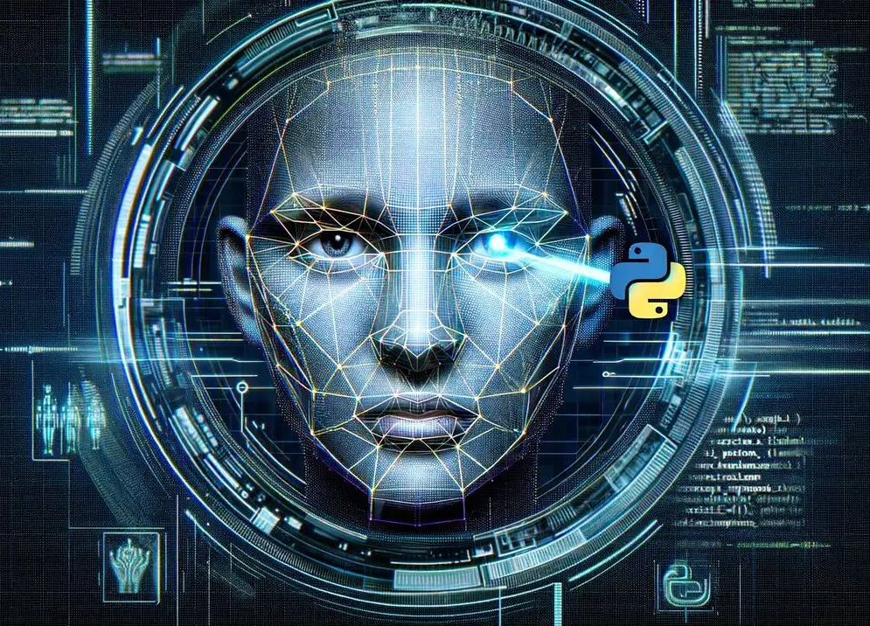







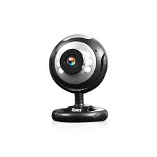
Requirements
The project required specific hardware and software components to ensure successful implementation and execution.
Hardware
Software
Computer/laptop with minimum 4GB RAM, I3 processor, and 128GB hard drive
Windows/Mac/Linux graphical operating system
Webcam with minimum 4 megapixels
Python 3.14
Visual Studio Code
Libraries: OpenCV, DeepFace

Slide 9
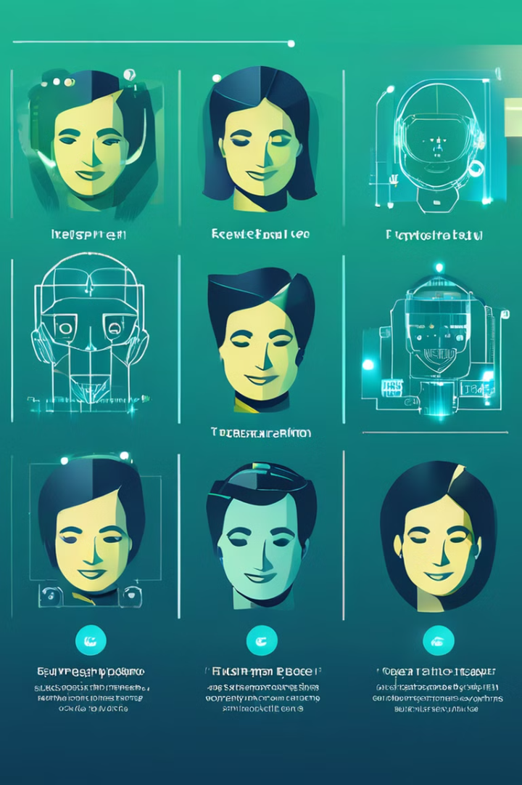
Project Summary
The Facial Impression Recognition System aims to detect and classify human facial expressions in real-time using Python, OpenCV, and deep learning techniques. The system identifies common facial expressions such as happiness, sadness, anger, surprise, fear, and neutral emotions, making it applicable in various fields such as human-computer interaction, behavioral analysis, and emotion-based AI systems.
1
Face Detection
The system utilizes OpenCV to detect faces in real-time from a webcam feed, identifying the location and size of each face within the video frame.
2
Emotion Recognition
DeepFace, a deep learning library, is employed to analyze the detected faces and classify the dominant emotion being expressed, leveraging pre-trained models and potentially fine-tuning them for improved accuracy.
3
Result Display
The identified emotions are displayed on the video feed in real-time, along with visual indicators (rectangles) around the detected faces, providing an intuitive and interactive experience for users.

Slide 10





The development of the Facial Impression Recognition System involved several key steps, including creating a virtual environment, installing required libraries, setting up VS Code, importing Haar Cascade for face detection, and running the application.
Create a Virtual Environment
A virtual environment was created using the "python -m venv myenv" command, providing a dedicated space for project dependencies and isolation.
Install Required Libraries
Necessary libraries, such as numpy, opencv-python, and deepface, were installed using pip, ensuring the availability of essential tools for image processing and emotion analysis.
Setup VS Code
Development Structure
VS Code was opened and navigated to the project folder, where a new file named main.py was created to house the code for the system.
Import Haar Cascade for Face Detection
The Haar Cascade classifier, downloaded from the OpenCV GitHub repository or obtained from the OpenCV package, was loaded in main.py to enable face detection.
Run the Application
The code was executed in VS Code's terminal using the "python main.py" command, initiating the real-time emotion detection process.

Slide 11
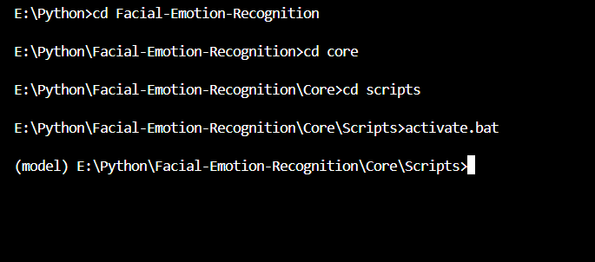
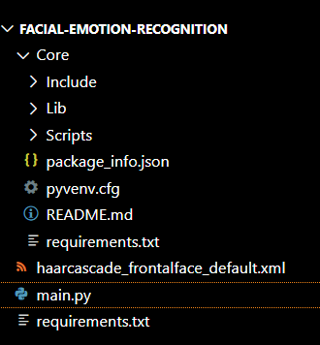
Create a Virtual Environment

Slide 12
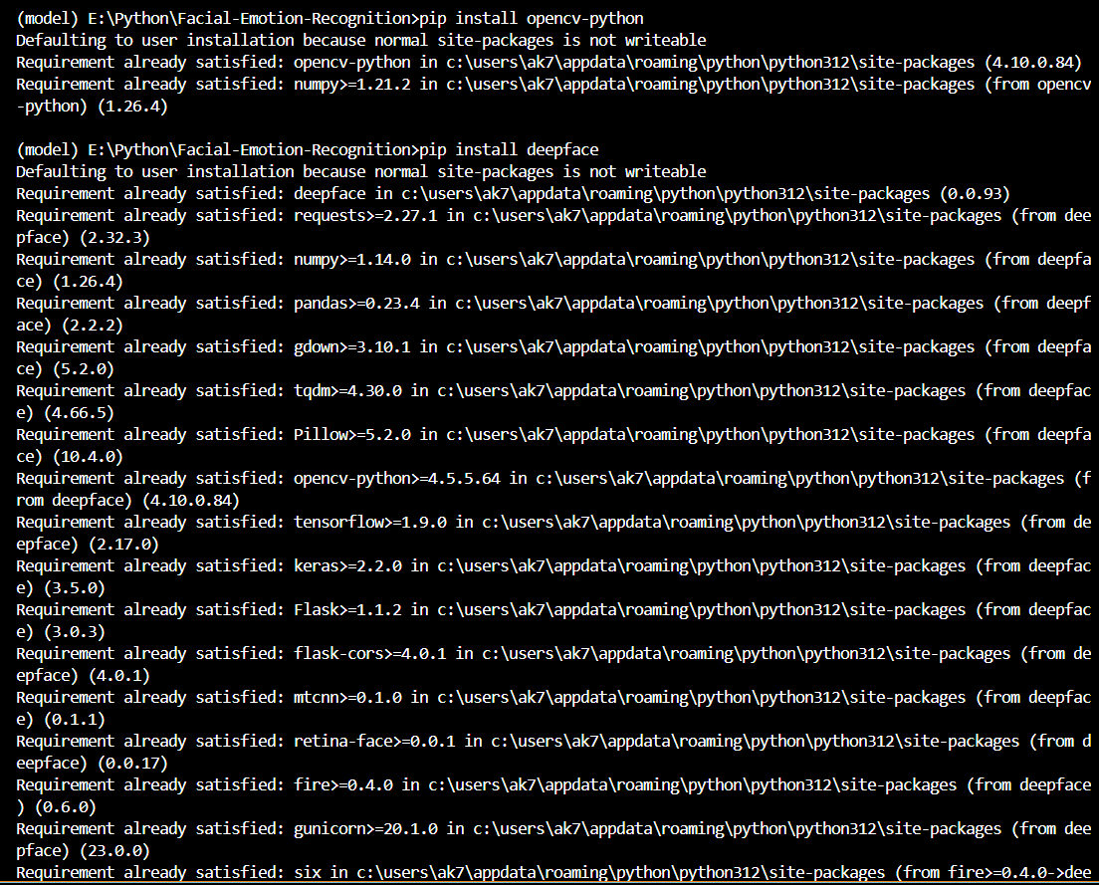
Install Required Libraries
OpenCV
DeepFace

Slide 13
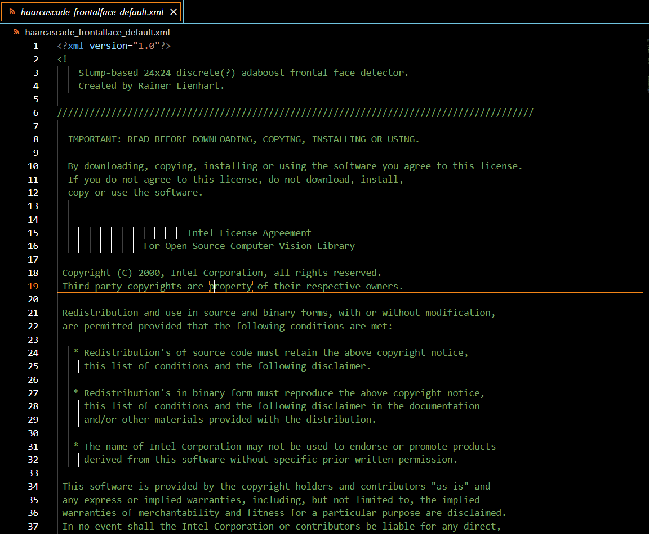
Source of trained data
Found from Kaggle website
Import Haar Cascade for
Face Detection

Slide 14
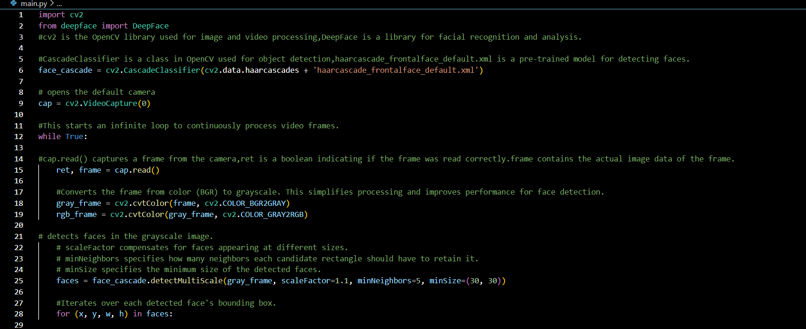
Code

Slide 15
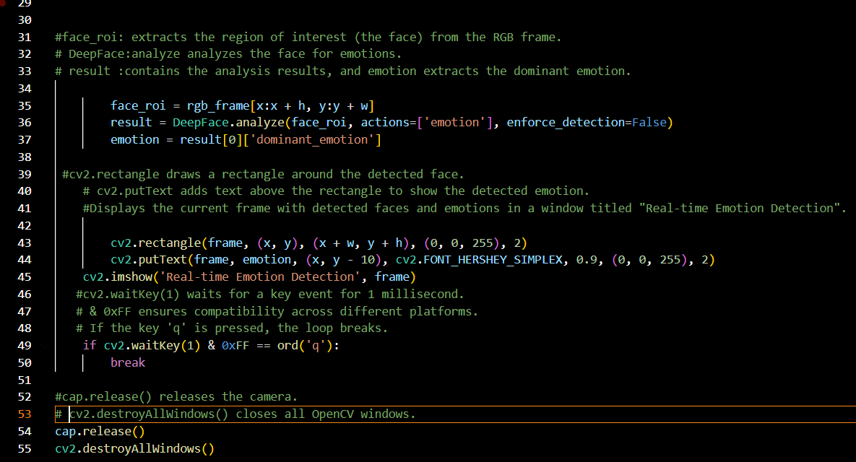
Code

Slide 16
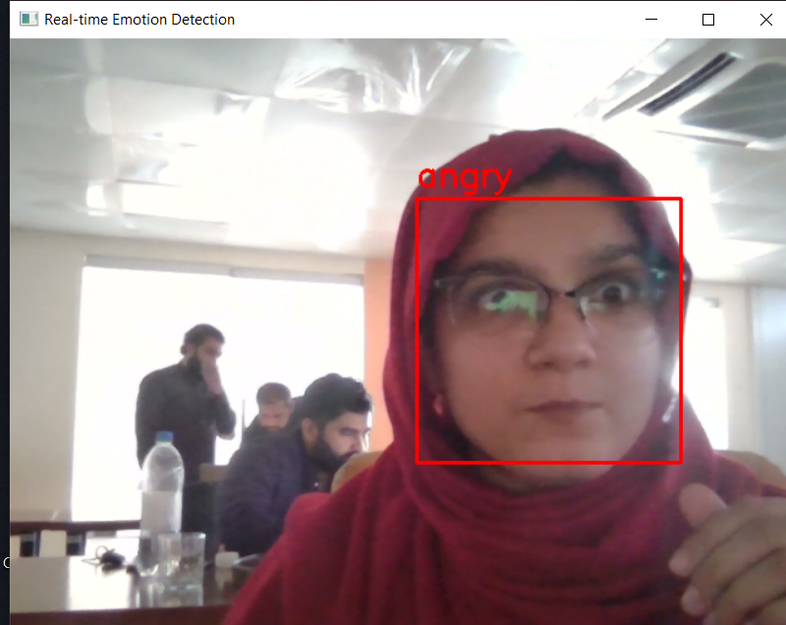
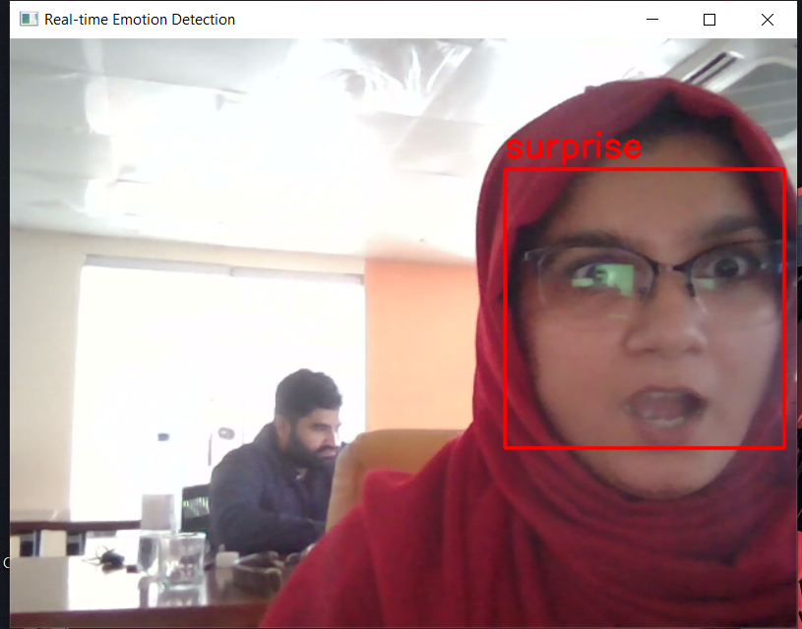
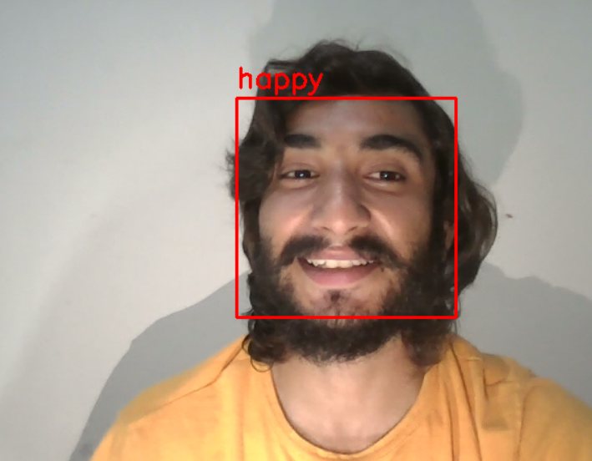
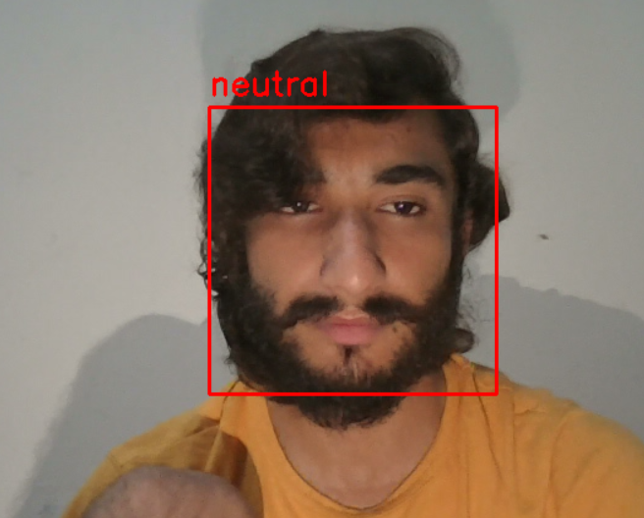
Run the Code

Slide 17

Conclusion
The facial expression recognition detector implemented in Python provides a robust solution for real-time emotion analysis. By leveraging OpenCV for face detection and DeepFace for emotion recognition, this code can effectively identify and display emotions such as anger, sadness, happiness, disgust, surprise, fear, and neutral. This technology has vast applications, from enhancing user experience in applications to aiding in psychological studies. As we continue to explore the intersection of technology and human emotion, tools like this will play a crucial role in bridging the gap between machines and human understanding.

Slide 18
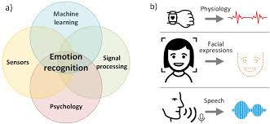
Future Work
Improving Accuracy and Speed:
Experiment with different machine learning models.
Optimize code and hardware (e.g., using GPUs).
Expanding to Multimodal Emotion Detection:
Combine with voice tone and body language for more accurate detection.
Cross-Platform Compatibility:
Develop mobile and web versions of the system.
Ethical Considerations:
Ensure user consent and data privacy.

Slide 19
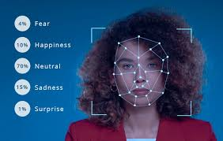
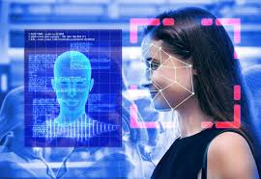
Thank You

Slide 20



Any Question

